Slide 1

Autonomous System Project
Distributed ROS 2 Navigation Architecture
Team Number: #18
Course: MCTR1002 | Autonomous Systems
Authors: Y. Mohamed, B. Walid, S. Hany, S. Magdy, Y. Hesham, M. Shakweer
Welcome to our presentation on the Team 18 Autonomous System Project. We have developed a high-performance navigation stack using a distributed processing architecture.

Slide 2
EXECUTIVE SUMMARY
This project validates a highly effective, dual-board autonomous driving architecture. By distributing computational load between a Raspberry Pi 5 and Arduino Uno, we eliminated bottlenecks, ensuring crisp responses across complex track environments including straight tracks, obstacle-rich racing circuits, and high-curvature city routes.
Our core objective was to create a reliable vehicle capable of navigating varied environments by separating high-level planning from low-level actuation.

Slide 3
DISTRIBUTED SYSTEM ARCHITECTURE
The Sense-Plan-Act Framework
We implemented a modular architecture split into two main layers:
•
High-Level: Raspberry Pi 5 manages ROS 2 trajectory generation and Pure Pursuit calculations.
•
Low-Level: Arduino Uno handles PWM motor regulation and real-time sensor polling.
•
Communication: High-speed 115200 baud serial connection over USB.
By assigning heavy geometric logic to the Pi 5 and critical timing tasks to the Arduino, we achieved a stable loop rate of 20 Hertz for lateral control.

Slide 4






HARDWARE COMPONENT STACK
Computing
Sensing
Actuation
Raspberry Pi 5 (8GB) paired with Arduino Uno for dual-core task isolation.
MPU6050 IMU for orientation and 11 PPR encoders for longitudinal tracking.
JGA-25-370 Geared DC motor and high-torque steering servo for precise control.
Our hardware stack was chosen to balance power and precision. The Pi 5 gives us the headroom for future AI-based planning.

Slide 5


LOCAL STATE ESTIMATION
Dead Reckoning
Key Features
Local position tracking is maintained via Euler integration on the MCU to minimize latency.
•
High-rate position updates at 100Hz.
•
Synchronized coordinate frames between Pi and Arduino.
•
MPU6050 yaw drift compensation via pre-sampled bias thresholds.
Accurate localization is the foundation of navigation. We use standard dead reckoning formulas updated in real-time.

Slide 6

DIGITAL SIGNAL FILTRATION
To mitigate sensory noise and chassis vibrations, we implemented first-order low-pass filters:
Speed & Heading Filter
•
Gyro Scaling: Calibrated with a 1.0256 factor to correct accumulated yaw drift.
•
Encoder Filtering: 0.943 calibration factor handles wheel slip errors.
Raw data is often noisy. These filters ensure the control algorithms receive smooth, reliable input.

Slide 7







PATH PLANNING APPROACHES
Straight Track
Racing Track
City Track
Pure longitudinal tracking targeting theta=0 with boundary braking at 10m.
Predictive lane changes between y = ±0.25m to bypass static hazards.
22-point dense waypoint circuit with acute corners and varied tangents.
Our system was tested across three scenarios, ranging from simple straight lines to complex urban layouts.

Slide 8


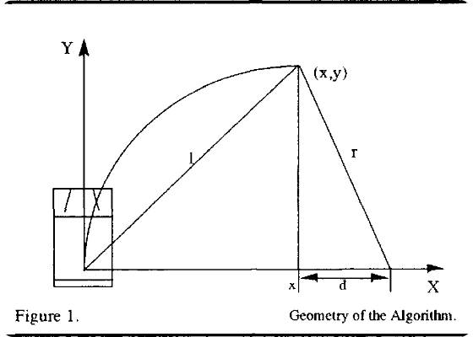
PURE PURSUIT LATERAL CONTROL
Geometric Path Tracking
We use a speed-scaled lookahead distance to identify the target coordinate on the trajectory.
Pure Pursuit allows for smooth steering by aiming for a lookahead point, naturally handling path curvature.

Slide 9
ACTUATOR CONTROL LOGIC
Actuator | Input Source | Control Logic | Output Range
DC Motor | Serial (Vel) | Proportional Closed-Loop | PWM 0 - 255
Steering Servo | Serial (Angle) | Exponential Smoothing | 45° - 135°
Logic Layer | Filtered IMU/Encoder | BasePWM + Error Scaling | Real-time Adjust
The Arduino converts high-level commands into precise electrical signals for our motors and servos.

Slide 10
PERFORMANCE ANALYSIS: CITY TRACK
Trajectory Stability
The city track lap demonstrates excellent cornering management.
•
Lap Completion: 100% success rate.
•
Yaw Accrual: Continuous accumulation reaching ~360° for a full lap.
•
Velocity: Maintained a consistent 0.185 m/s despite varied steering loads.
In our most complex test, the city circuit, the robot maintained a stable speed while accurately rounding sharp corners.

Slide 11
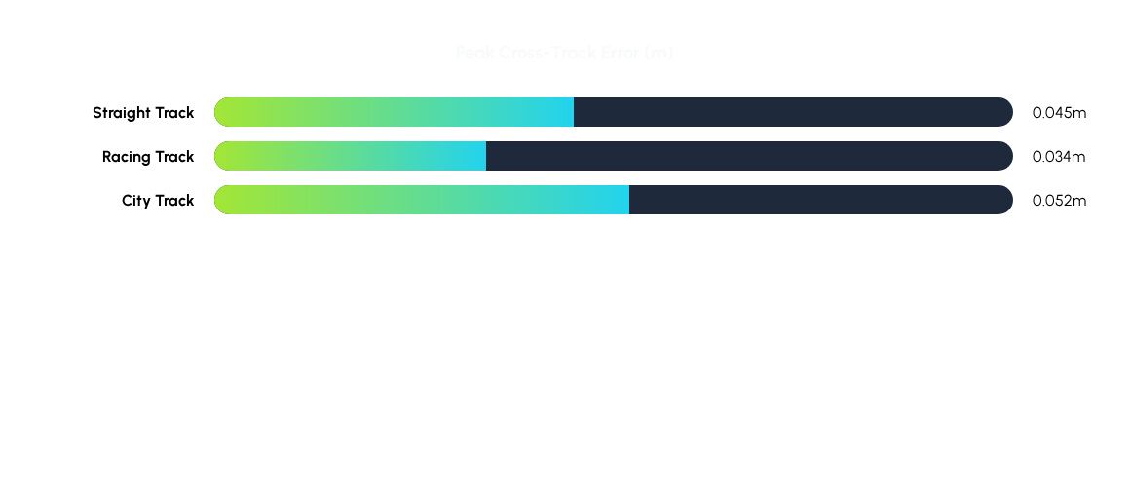
EXPERIMENTAL RESULT SUMMARY
Data confirms that the unified stack successfully minimizes errors across all physical environments.
Quantitatively, our lateral error remained below 6 centimeters in all cases, which is well within our target safety margins.

Slide 12


CONCLUSION & FUTURE OUTLOOK
Accomplishments
Next Steps
•
Validated dual-board RPi-Arduino architecture.
•
Migration to Model Predictive Control (MPC).
•
Successful hazard avoidance and lane shifting.
•
Integration of obstacle detection via LiDAR/Vision.
•
Robust noise filtration for real-world sensing.
•
Optimization for high-speed volatile environments.
Thank you! Any Questions?
In conclusion, we've built a robust platform. Looking ahead, we plan to implement Model Predictive Control to further enhance high-speed stability.

